Slide 1
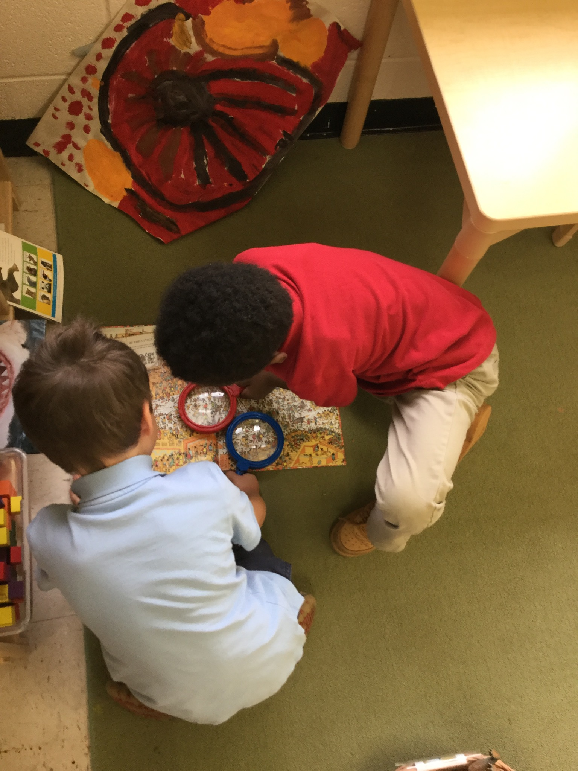
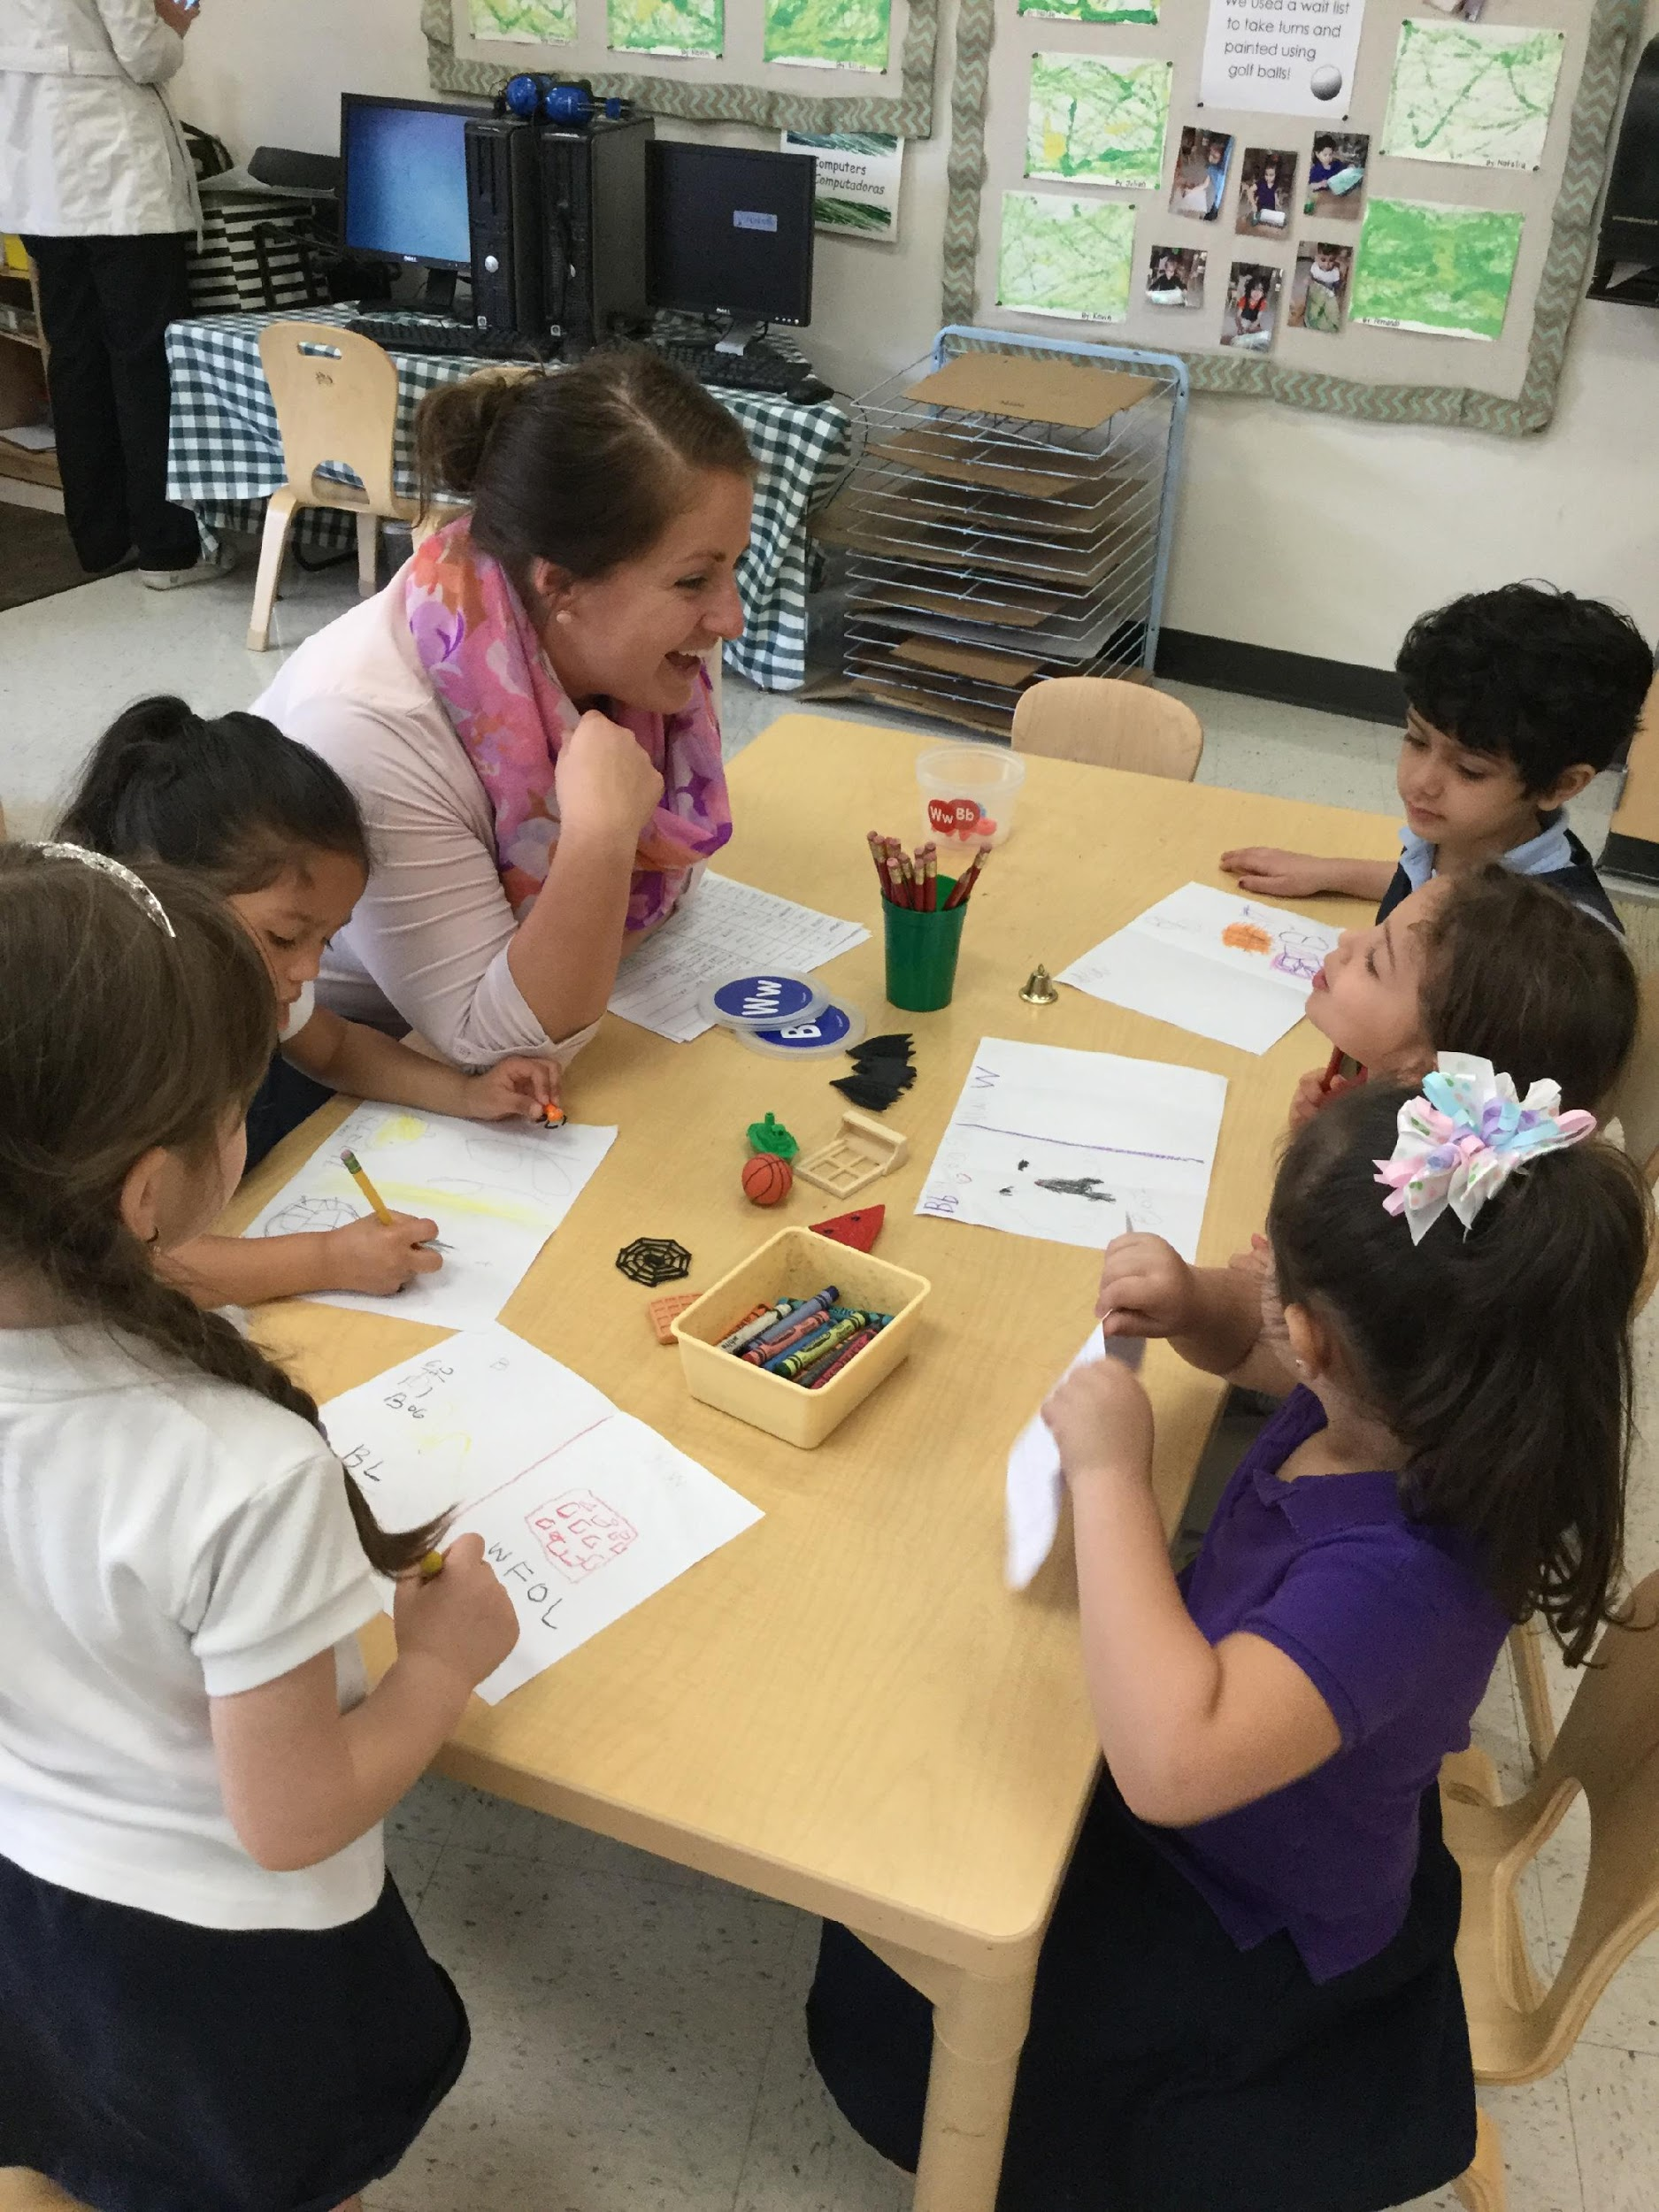
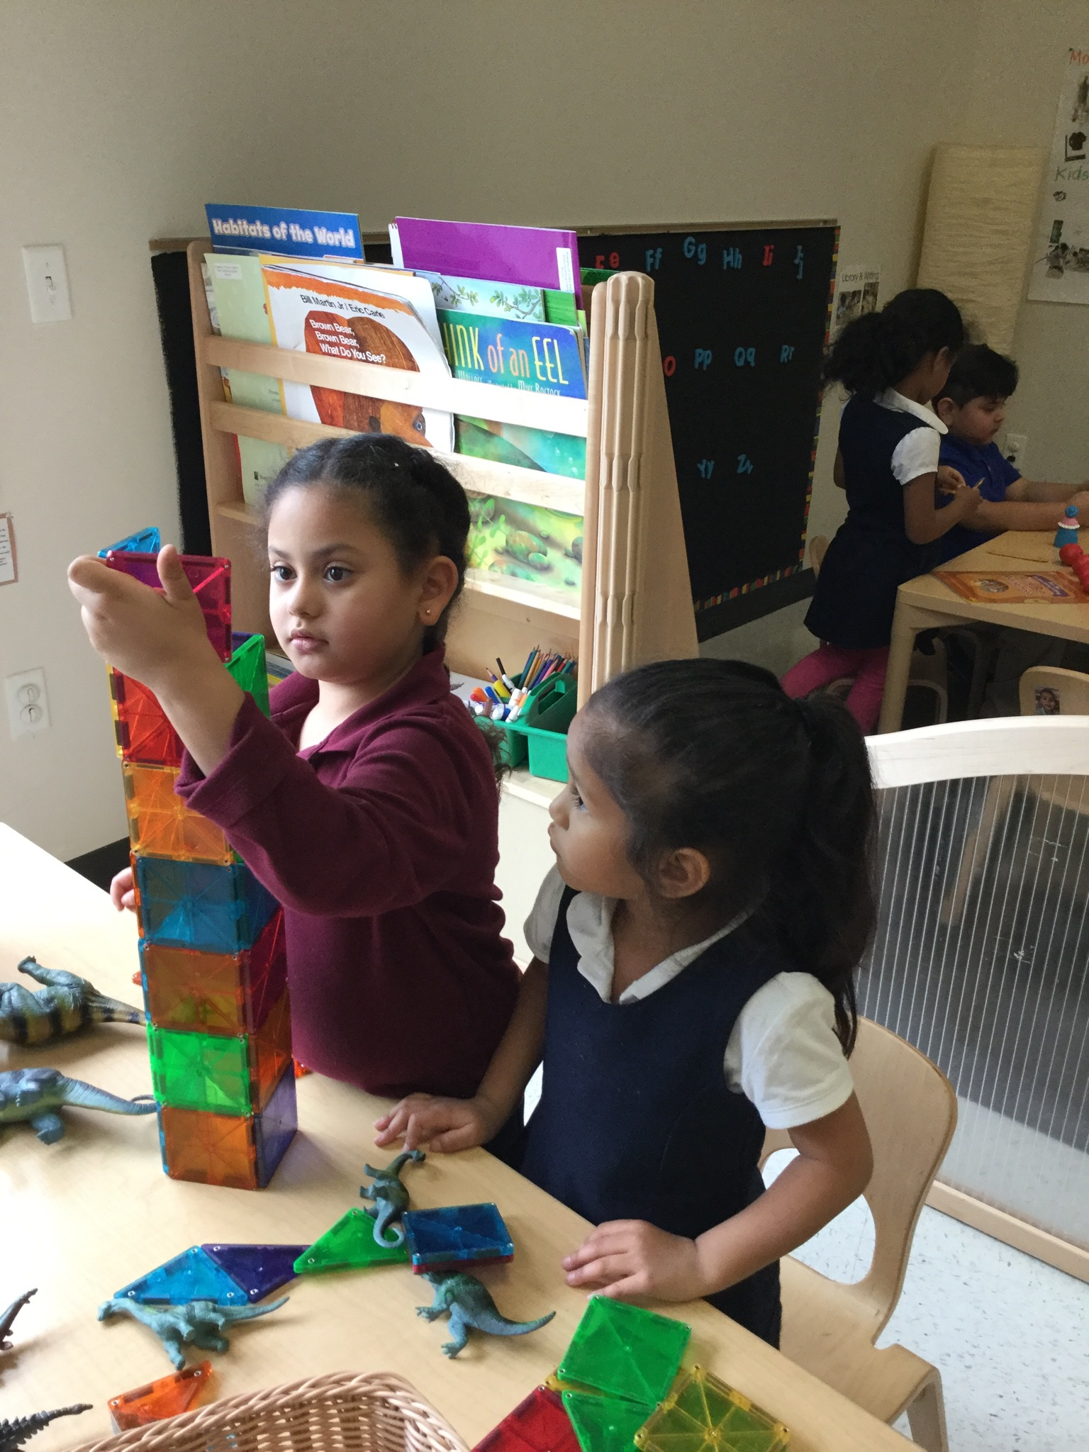
Promoting Associative & Cooperative Interactions
CHALK PROFESSIONAL DEVELOPMENT SERIES

Slide 2
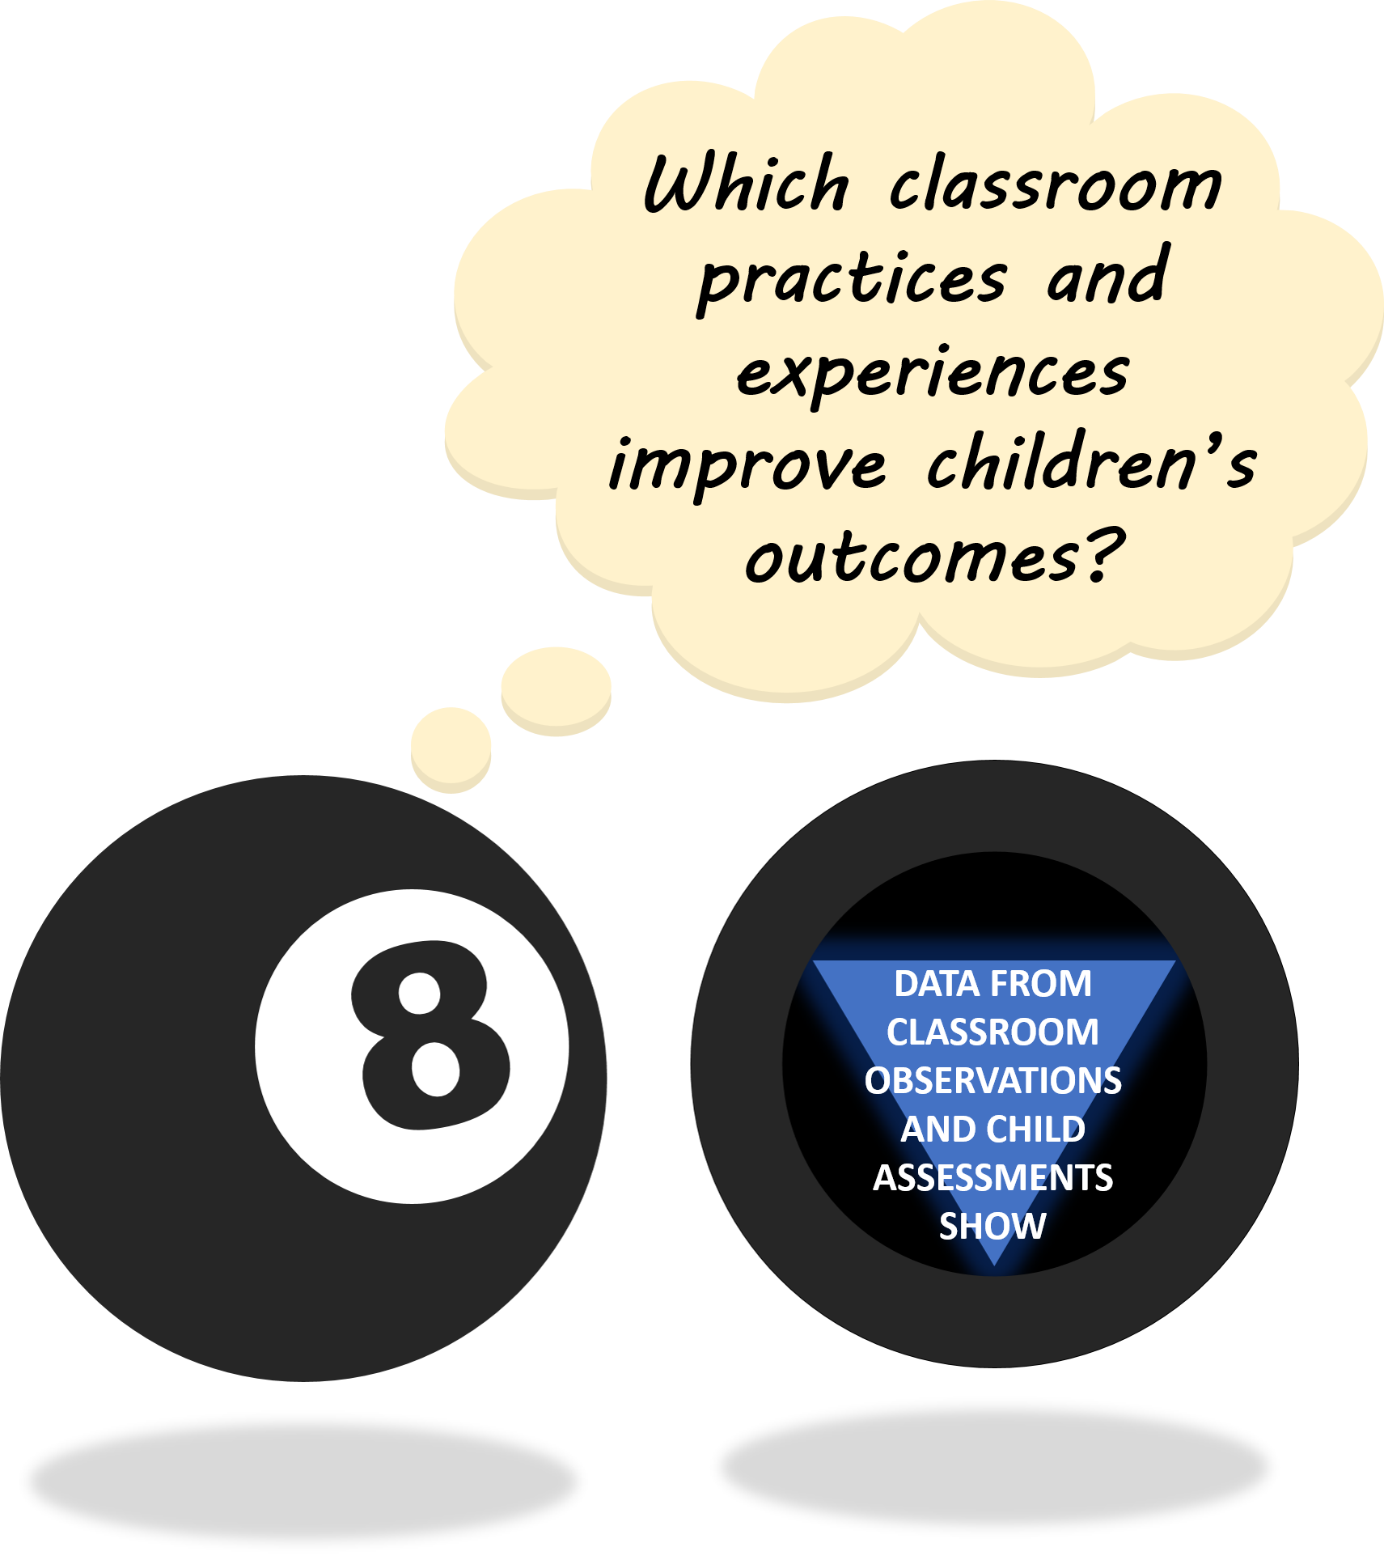
THE “MAGIC 8” CLASSROOM PRACTICES
Reduce time spent in transition
Improving level of instruction
Creating a positive climate
Increasing teacher listening to children
Planning sequential activities
Promoting associative and cooperative interactions
Fostering high levels of engagement
Providing math opportunities
★ 2017-18 Initiative: Focus on Literacy ★

Slide 3
TYPES OF SOCIAL LEARNING INTERACTIONS
Parten’s Stages of Developmental Play describe the social parameters of a child’s learning experience. Children’s interactions are determined by:
Individual preference (favorite friends)
Developmental competence (socioemotional and language skills)
Opportunities provided
(adults allowing/encouraging discussion and partner work)
Cooperative
Organizing toward a shared goal with clear roles and structure
Associative
Using shared materials to co-construct an idea or experience
Unoccupied
Not attending to any activity
Stages of Play
Parallel
Playing near other children with similar materials
Solitary
Playing alone with unique materials
Onlooker
Observing other activities without participating
Associative and Cooperative interactions require higher levels of participation and engagement with peers.
Notes:
Add citation
Parten, M. B. (1932) Social play among preschool children.

Slide 4

ASSOCIATIVE LEARNING INTERACTIONS
Shared materials
Communicate about task with peers
Co-construct a product or idea
Generally open-ended with no distinguishable goal
Interaction would change if a child walked away
EXAMPLES:
Completing a puzzle together
Sharing a book
Helping with a task (e.g., spelling or counting)
Conversation/Brainstorming
Associative interactions allow children to learn from each other.
Notes:
Notes from 2/20 meeting:
- In which settings/areas do children tend to play together?

Slide 5
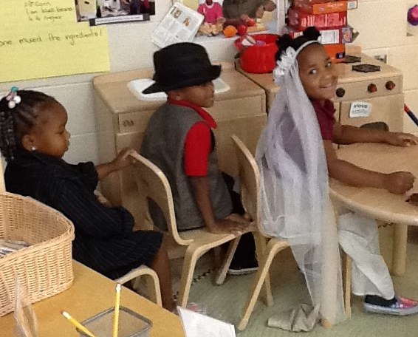
COOPERATIVE LEARNING INTERACTIONS
Work together with shared goals and formal organization (i.e., rules, turn-taking)
High-level dramatic play
Recognizable scenario
Appropriate role speech
Interactions that follow a script (sequence of expected behaviors for situation)
RESTAURANT
WEDDING
VETERINARIAN’S OFFICE
LAUNDROMAT
Wedding scenario with children enacting roles of bride, groom, officiant, and guests.
Sequence includes writing invitations, getting ready, and driving to wedding.
Notes:
Notes from 2/20 meeting:
Formal games that emphasize working toward common goal (vs win/lose) – Peaceable Kingdom?
Cooperative =/= “cooperating”
-make this distinction clear to teachers?
Behavioral script: sequence of expected behaviors for a given situation

Slide 6
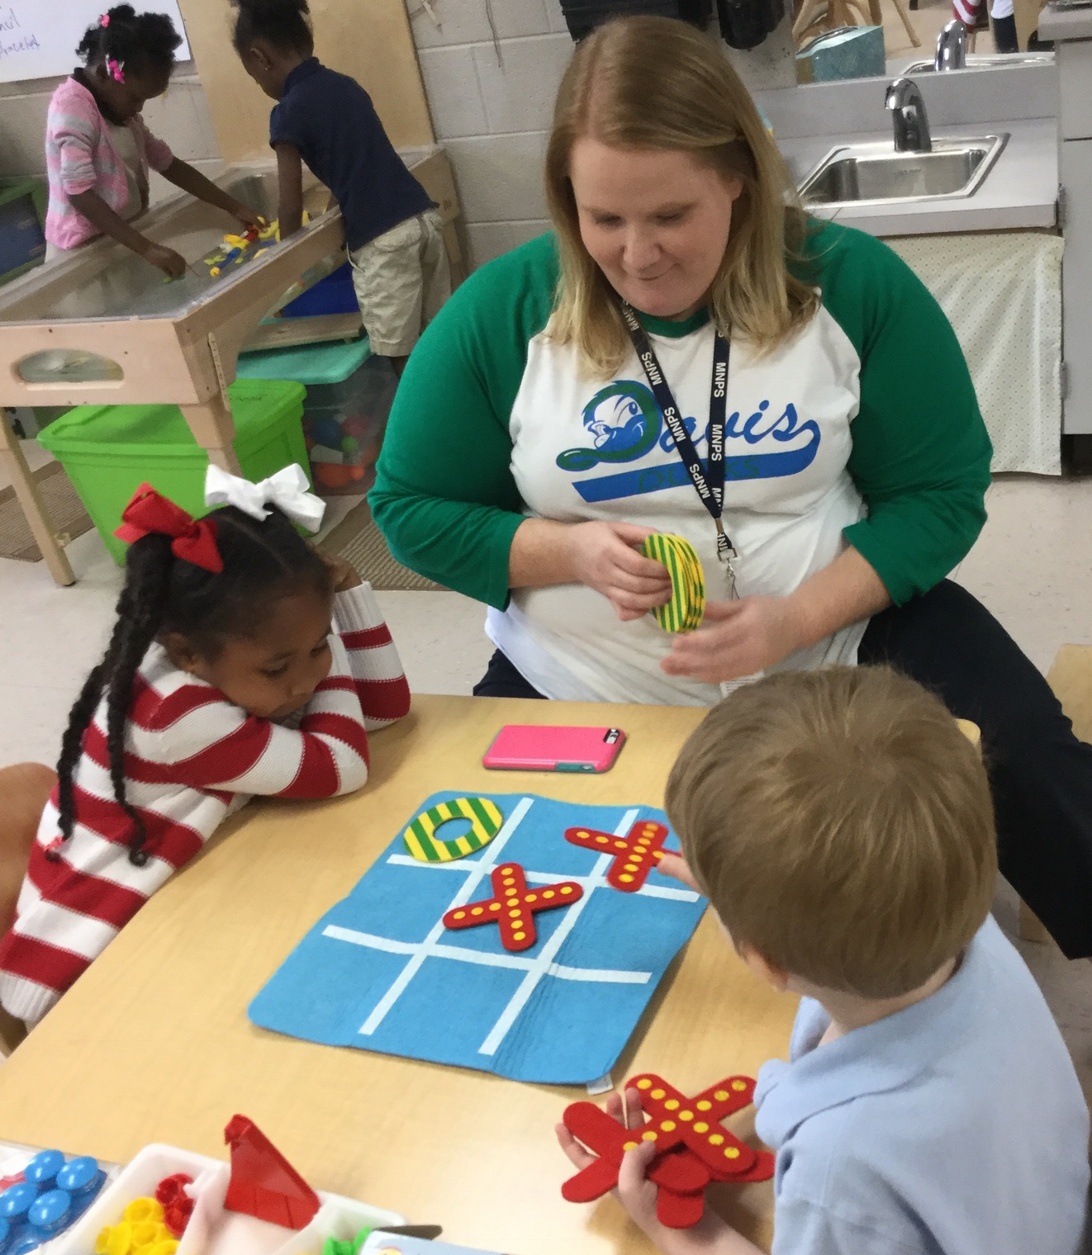
THE ROLE OF SOCIAL INTERACTIONS IN CHILDREN’S LEARNING
Associative and Cooperative interactions require children to:
Communicate and work with peers
Monitor their own behavior
Adapt to the needs and expectations of others
Children observed learning in social interactions made greater gains in:
Math
Vocabulary
Self-regulation
Better social competence & fewer problem behaviors in 1st grade (Spivak & Farran, 2014)
These social skills serve as the basis for teamwork and collaboration in later schooling and life.
Notes:
GAINS:
Vocabulary (lower skills)
Self-regulation (lower skills)
* also contributes to involvement
Greater social competence & fewer problem behaviors in 1st
Math (full sample, yr 1)
SR (full group)
Literacy (lower skilled)

Slide 7

SUPPORTING ASSOCIATIVE & COOPERATIVE INTERACTIONS
How do we show someone we are listening?
Model interpersonal skills required for social learning interactions
Teach respectful talking and listening skills
Encourage children to express how they are feeling when these interactions don’t go as planned
Give positive feedback when things are going well
Demonstrate rules and turn-taking when introducing formal games
You and Sara both have very important ideas to share.
I lost, but that’s ok. Maybe I’ll win next time!
Hmm…it sounds like Bailey would rather play alone right now. What could we do instead?
How can we support our friends while we wait for our turn?
DISCUSSION POINT:
What resources are available to help you teach socioemotional skills?
Notes:
Notes from 2/20 meeting:
Praise child’s effort vs win/lose (played well, had fun, supported friends)
Acknowledge that losing doesn’t feel good
2nd step, Pyramid, other curricular support (How are you using those resources?) – emphasize CONSISTENCY
What are some barriers to social learning interactions in your classroom?

Slide 8
SUPPORTING ASSOCIATIVE & COOPERATIVE INTERACTIONS
Join in on the fun!
Participate in the first few rounds of a formal game to make sure everyone understands the rules
Gracefully enter and exit children’s play
Use language facilitation strategies to help children understand each other
Help children who have a hard time engaging with others feel included
Oops! It’s not my turn…that means I keep my hands to myself and send good luck vibes to Charlie!
Tyler, try saying: Can I play with you?
Thank you for this gorgeous new haircut! I must get to my next appointment now.
Why don’t you ask Cooper what he thinks about the new ice cream flavor?
DISCUSSION POINT:
What are some barriers to social learning interactions in your classroom?
Notes:
Notes from 2/20 meeting:
Emphasize teacher/EA role during centers
Adults play important role in elevating play🡪 more Assoc/Coop
What are specific strategies you could use to support individual students?
Stanton-Chapman (2015) calls this the “play enhancer” role
Strategies for scaffolding children through interactions
Also include shoulder partner prompts?
JN- sure! Also, i’m wondering about cooperative activities like games with turn taking. Maybe we could add a slide specifically about how to incorporate cooperative activities in different settings and across different content areas (just an idea)

Slide 9
SUPPORTING ASSOCIATIVE & COOPERATIVE INTERACTIONS
Set up spaces and activities to encourage interaction between children
Balance the number of children in each center
Encourage partner work and discussion
Limit similar materials and encourage sharing
Suggest different roles for contributing to an activity
Turn to your shoulder partner and tell them your favorite part of Henny Penny.
We need a lot of people to run our pizzeria today!
It looks like we only have one geo-board today. You can work together to make interesting shapes.
For this activity, we need a Counter, a Checker, and a Recorder.
DISCUSSION POINT:
How can you “make over” some of your centers to promote social learning interactions?
Notes:
Notes from 2/20 meeting:
“buddy centers”
Make-over centers to promote interactions
Planning/engineering activities
Stanton-Chapman (2015) calls this the “stage manager” role
Also include shoulder partner prompts?
JN- sure! Also, i’m wondering about cooperative activities like games with turn taking. Maybe we could add a slide specifically about how to incorporate cooperative activities in different settings and across different content areas (just an idea)

Slide 10

SPECIAL THANKS & ADDITIONAL RESOURCES
We are grateful to the following MNPS Pre-K Instructional Coaches and Multi-Classroom Leaders for their invaluable feedback in developing these materials:
SeTara DeThrow
Carrie Head
Susan McClain
Stephanie Mullins
Holly Stone
Ashley Aldridge Wilson
Rhiannon Wilson
https://my.vanderbilt.edu/mnpspartnership/

Slide 11
INDIVIDUAL IMAGE SOURCES
FREQUENTLY USED IMAGES*
Lightbulb | myiconfinder.com
Designed by Vexels.com:
Hand drawn magnifying glass
Hand drawn bar graph
Pie chart hand drawn doodle
Hand drawn wall clock
Hand drawn cloud bubble
Hand drawn open book
Cog wheel hand drawn icon
*These graphics are used as icons throughout the series. For example this lightbulb clipart appears beside most “Discussion Point” questions.

